Slide 1


Slide 2


MINOR PROJECT REVIEW
GUIDED BY,
Dr.K.SheikDavood
TEAM MEMBERS,
1.Sujitha.G (927622BEC220)
2.Swathi.R (927622BEC226)
3.Swetha.K (927622BEC227)
4.Varshini.S (927622BEC242)

Slide 3
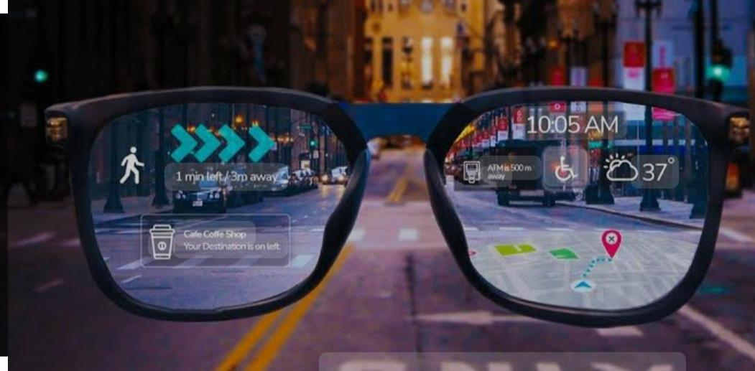
Smart Visual Aid Glasses for the Visually Impaired

Slide 4

Problem Statement
Visually impaired individuals struggle with safe and independent navigation due to the limitations of current assistive technologies, which often lack real-time spatial awareness and comprehensive environmental feedback

Slide 5
Objective
The project aims to develop Smart Visual Aid Glasses that significantly improve the quality of life for visually impaired individuals by enhancing their spatial awareness and mobility
Sensor Integration:
The glasses will incorporate advanced sensor technologies, including LiDAR, GPS, and cameras.
These technologies will provide real-time obstacle detection, navigation assistance, and object recognition.

Slide 6
Optical Transparent Antennas (OTAs):
OTAs will be integrated into the glasses.
They will support seamless wireless communication while maintaining clear visibility for the user.
Voice Recognition:
Voice recognition functionality will be implemented in a connected wearable device, such as a smartwatch, or alternatively in a mobile phone.
This feature allows for intuitive, hands-free operation.
System Design:
The comprehensive system is designed to empower visually impaired users with greater independence and confidence in navigating their surroundings.

Slide 7
Components
1. NodeMCU ESP8266 - Central microcontroller for managing and integrating data from all components.
2. LiDAR Sensor - For detecting obstacles and measuring distances.
3. GPS Module - For tracking location and assisting with navigation.
4. Optical Transparent Antenna (OTA) - For enabling wireless communication without blocking the user’s view.
5. Lens Material - Such as Trivex, for forming the lens and supporting embedded components.
6. Camera - For capturing and processing visual information to recognize and describe objects.

Slide 8
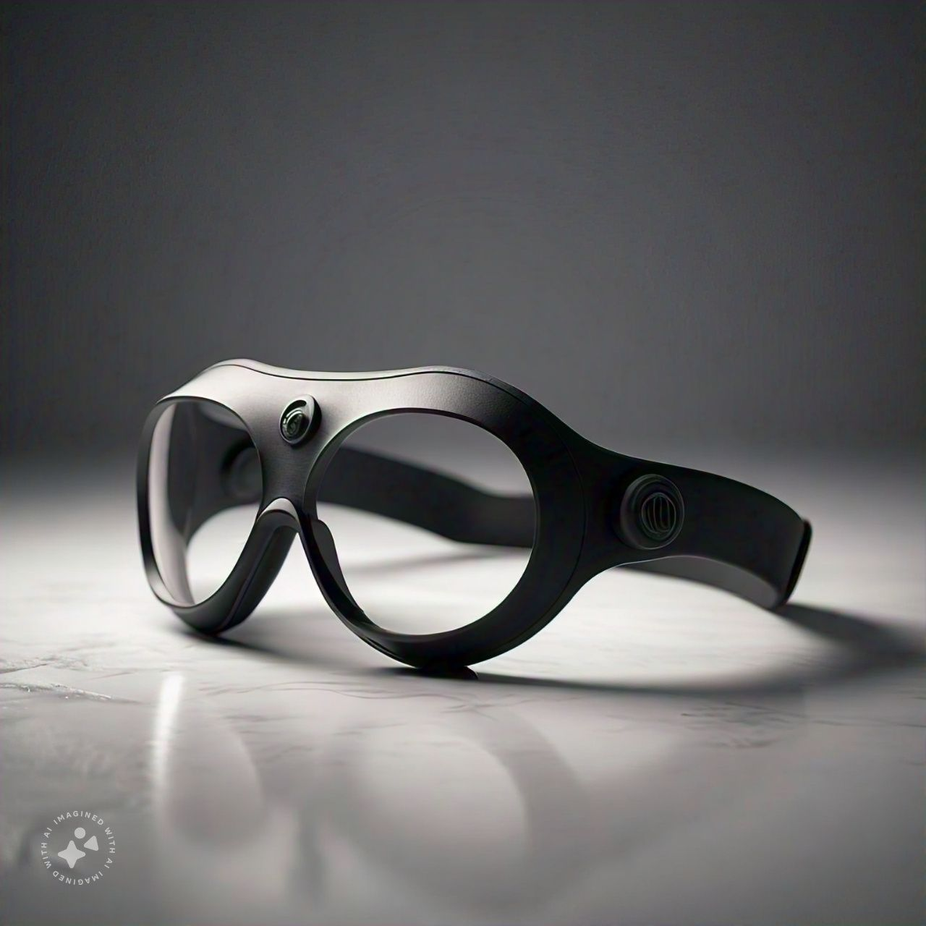
Features
1.Obstacle Detection
2. Location Tracking
3. Object Recognition
4. Wireless Communication
5. Voice Commands
6. Enhanced Awareness
7. Navigation Assistance
8. Real-time Feedback

Slide 9
Effectiveness of OTA in the Project:
Optical Transparent Antennas (OTAs) are highly effective in the Smart Visual Aid Glass project as they provide a crucial balance between functionality and aesthetics.
Their transparency allows for seamless integration into the glass lenses without obstructing the user's vision, maintaining the discreet and non-intrusive design of the glasses.
OTAs enable continuous wireless communication, ensuring that the glasses can transmit and receive data in real-time, which is essential for features like object recognition, navigation assistance, and obstacle detection.
Their low power consumption and high efficiency further enhance the overall performance and battery life of the device, making the glasses practical for daily use by visually impaired individuals

Slide 10


